Slide 1
The Role of Family in Religious Liminality
Simon G. Brauer
Ph.D. Candidate in Sociology
Duke University
simon.brauer@duke.edu
simonbrauer.github.io (website)

Slide 2
BACKGROUND
Affiliation
Somes
Nones
Liminals
2

Slide 3
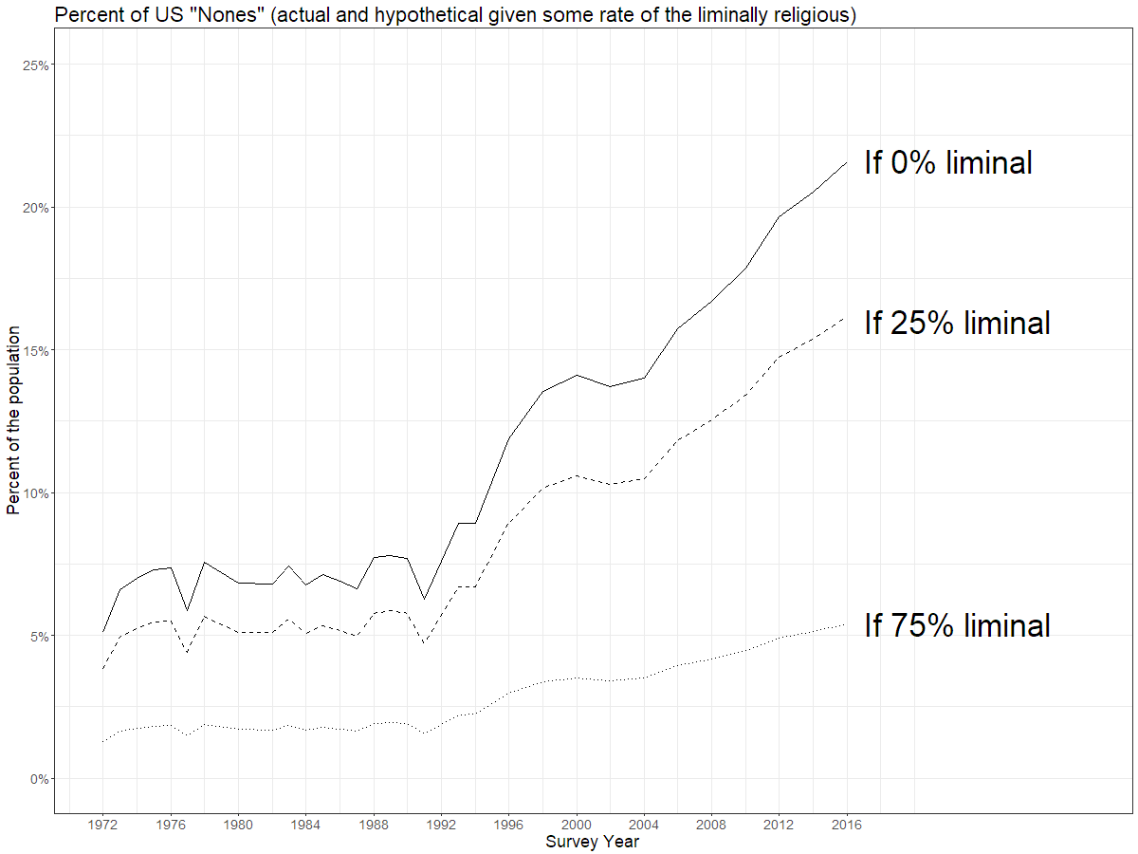
BACKGROUND
3

Slide 4
BACKGROUND
Intermediate state
Nones
Liminals
Somes
Liminals
Nones
Somes
Distinct state
4

Slide 5
Longitudinal Study of Generations
METHODS
1971
Wave 1: survey of 3-generation families in California, who have a Generation 1 male subscribed in a Los Angeles HMO
1985
1988
1991
Wave 4: added a fourth generation
1994
1997
2000
5
2005

Slide 6
Defining (ever) liminal
METHODS
Stopped affiliating
Previous
Service attendance
Never Weekly
Previous
Self-rated religiosity
Not at all Very
Started affiliating
Previous
Service attendance
Previous
Self-rated religiosity
6

Slide 7
Predictors
METHODS
Parents’ religious characteristics
Religious service attendance
Self-rated religiosity
Parents’ parenting attitudes
Rules should be flexible when raising children
People should change their lifestyle to align with their families’ values
All children should receive religious instruction
7

Slide 8
Analysis
METHODS
Bivariate descriptives
Multiple imputation
Multilevel logistic regression
“Bayesian rank-sum” test
8

Slide 9
What is a Bayesian rank-sum test anyway?
METHODS
<
2
3
2
1
3
4
2
3
1
2
9
Ever liminal
Never liminal

Slide 10
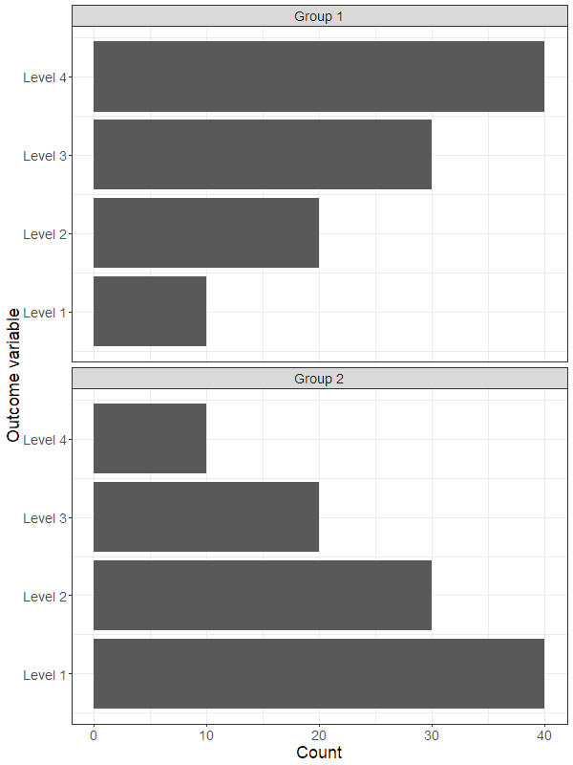
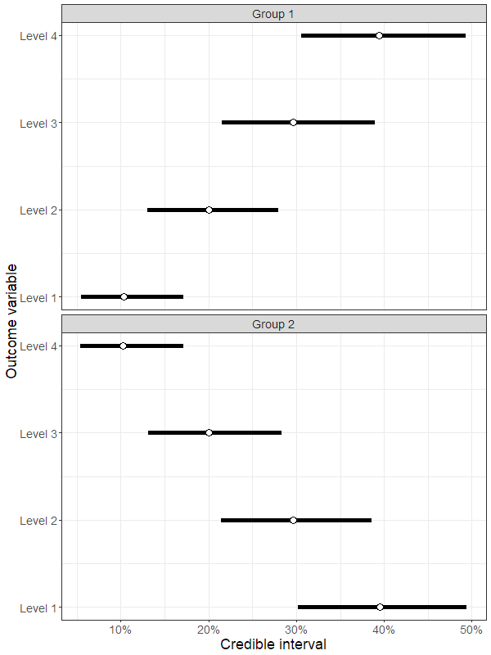
What is a Bayesian rank-sum test anyway?
METHODS
10

Slide 11
What is a Bayesian rank-sum test anyway?
METHODS
)
11

Slide 12
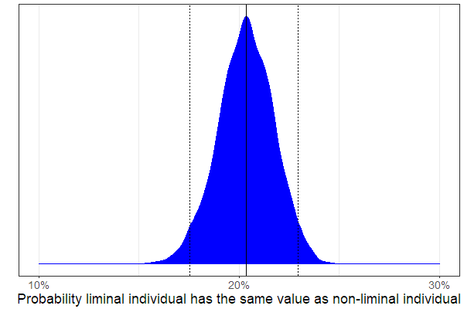
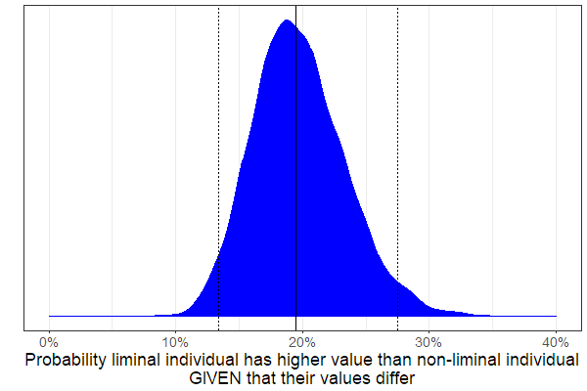
What is a Bayesian rank-sum test anyway?
METHODS
$$P\left(x_{L}<x_{N}\right)=0.4×0.3+$$
$$0.4×0.2+$$
$0.4×0.1+$
$0.3×0.2+$
$0.3×0.1+$
$0.2×0.1=0.35$
12

Slide 13
How many liminals are in the LSoG?
RESULTS
322 out of 3,655 respondents (9%)
Liminals make up…
…236/406 who switch once
…74/102 who switch twice
…12/47 who switch three times
…0/9 who switch four or five times
13

Slide 14
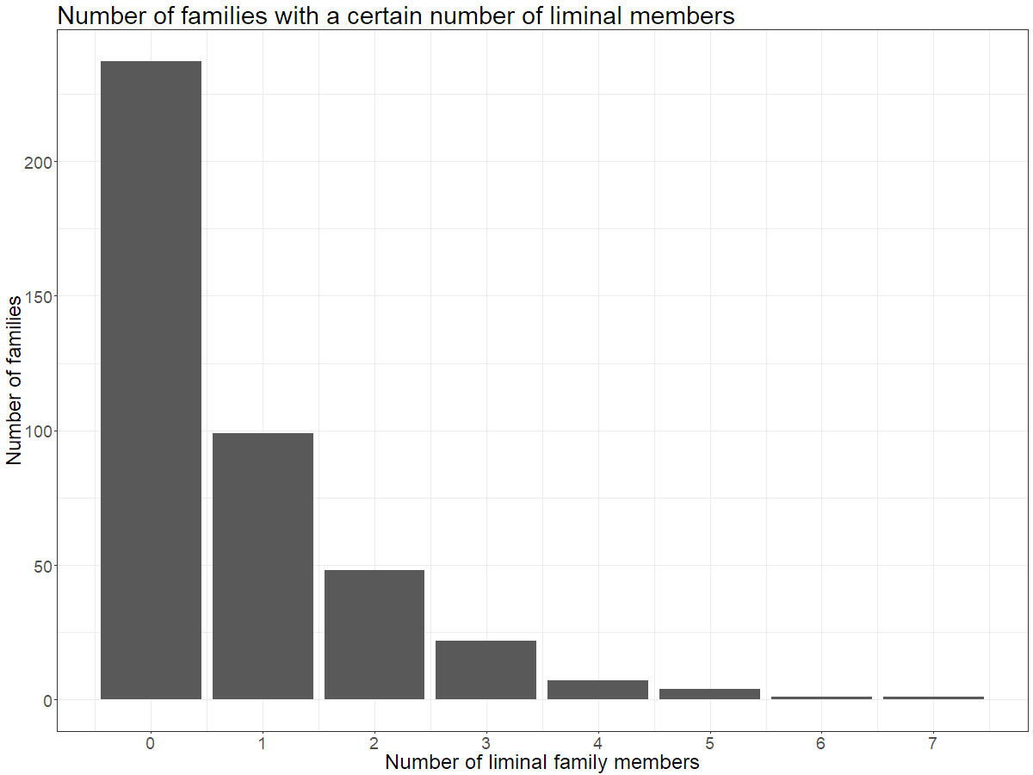
RESULTS
14

Slide 15
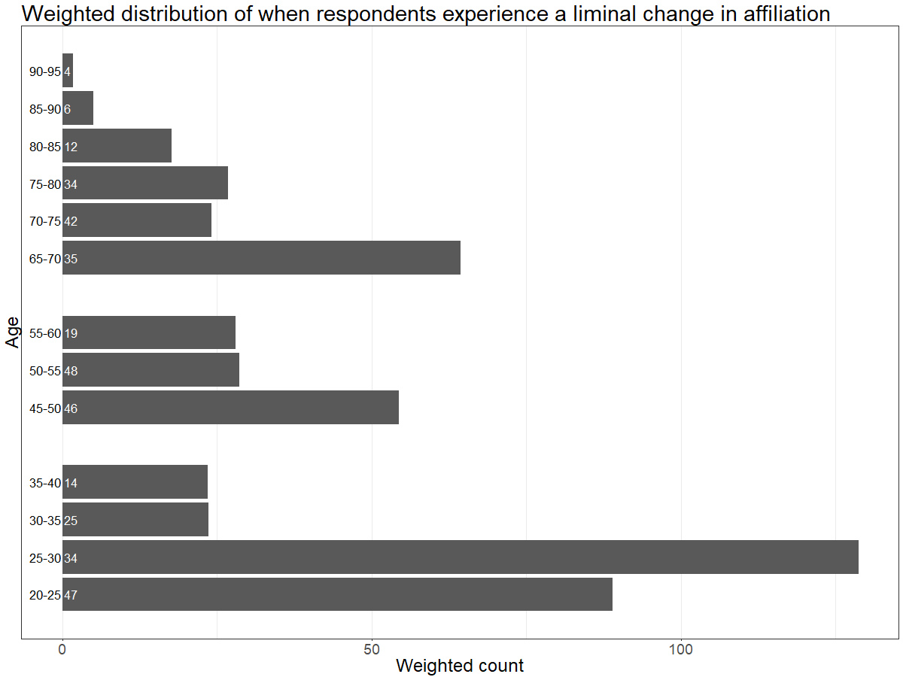
RESULTS
15

Slide 16
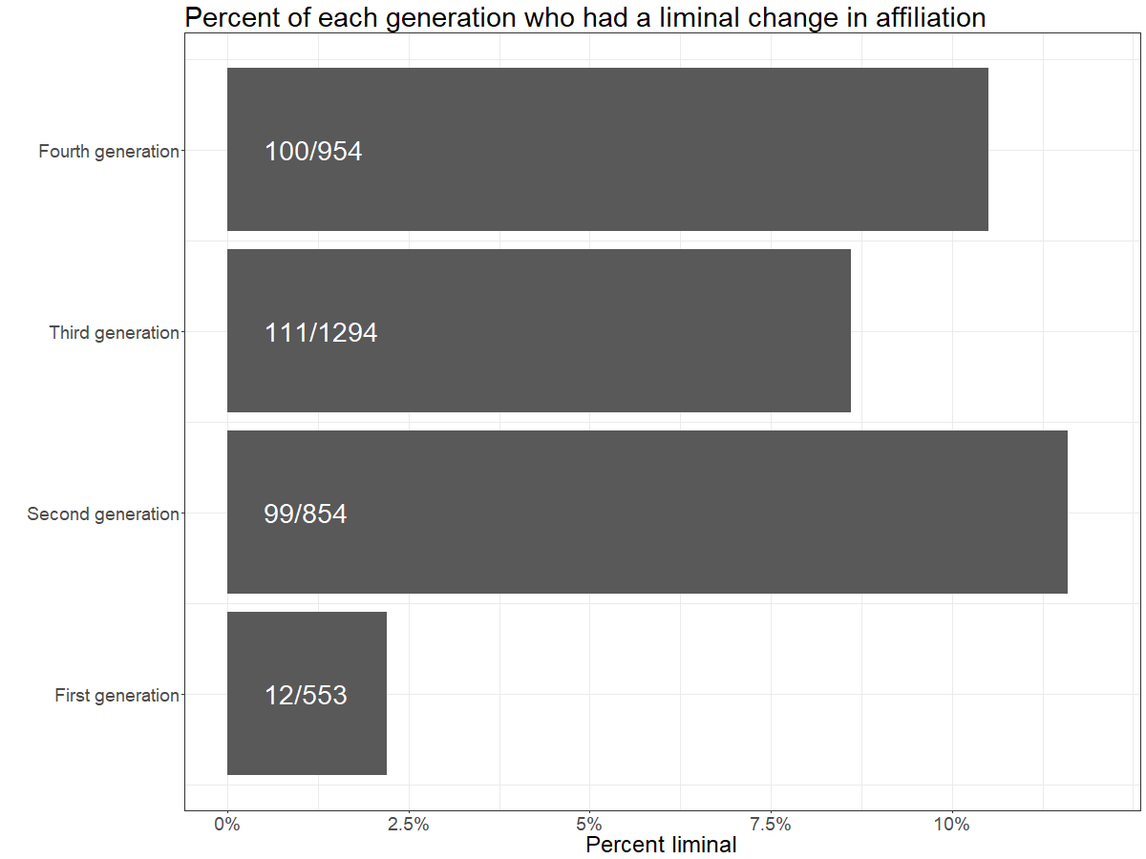
RESULTS
16

Slide 17
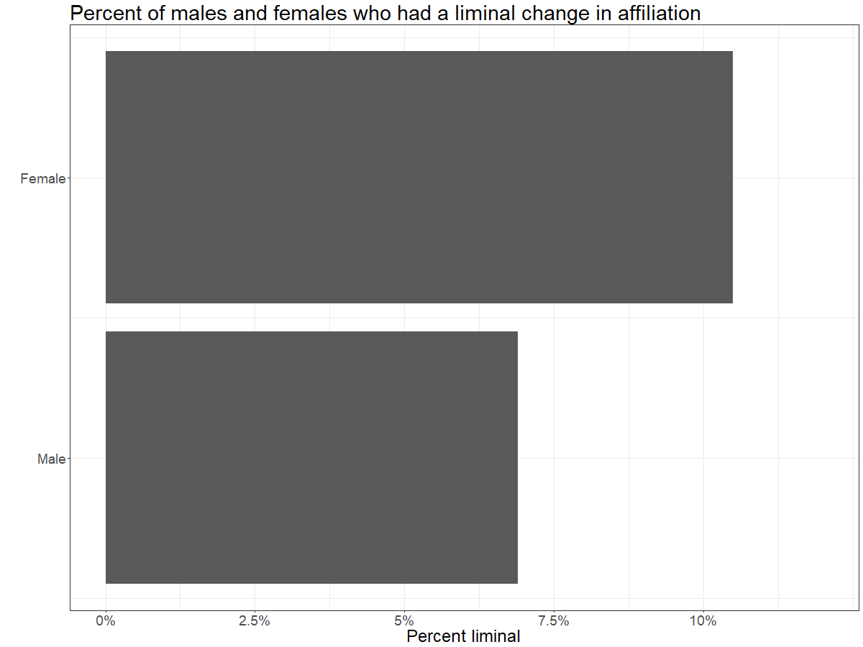
RESULTS
17

Slide 18
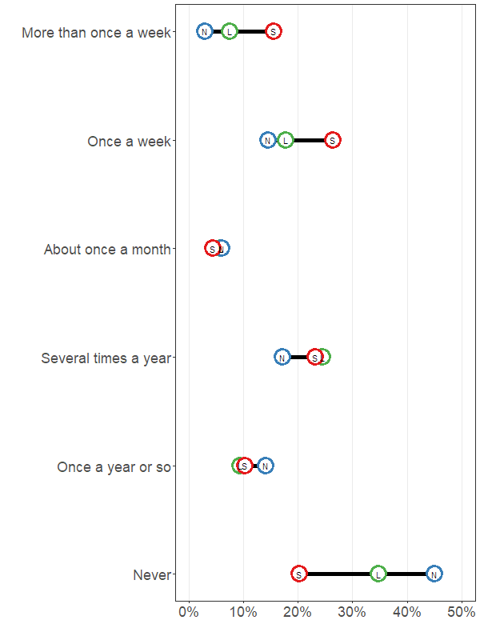
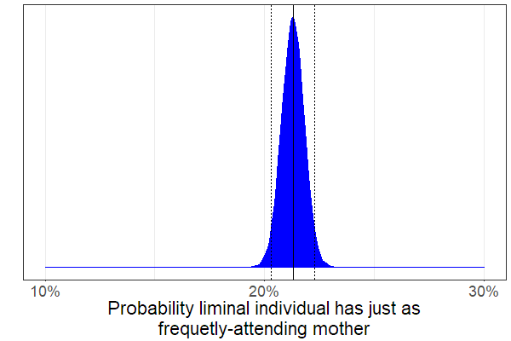
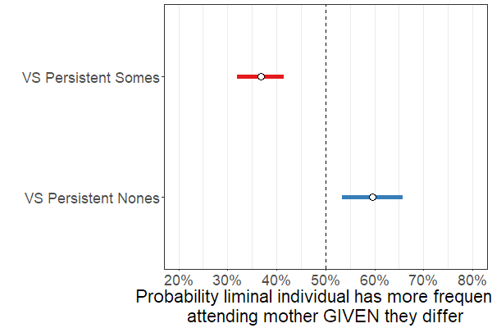
Religious service attendance (mother)
RESULTS
18

Slide 19
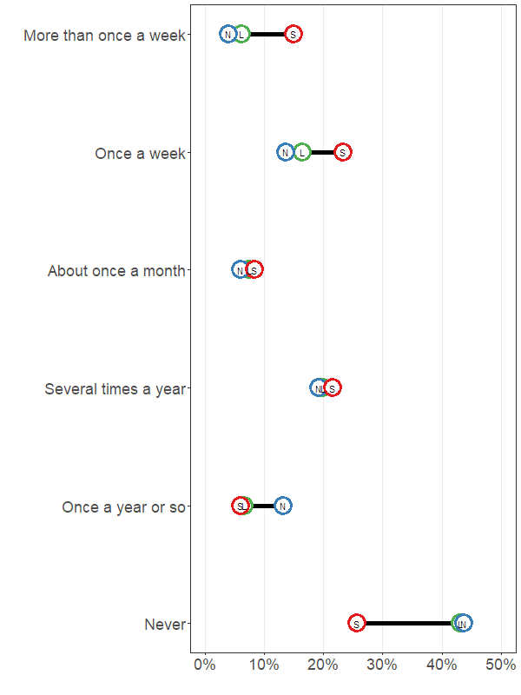
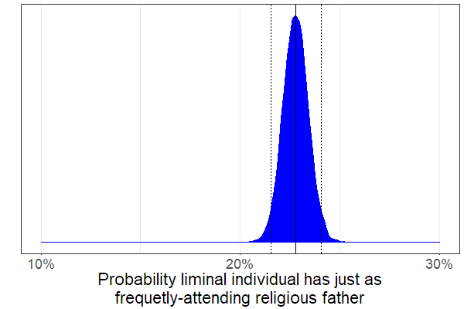
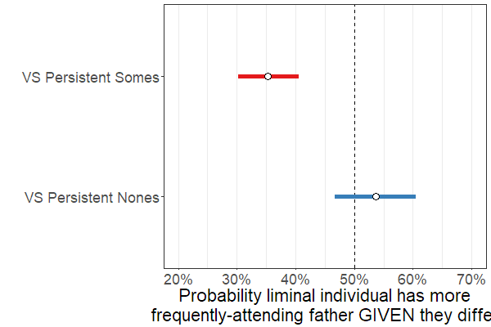
Religious service attendance(father)
RESULTS
19

Slide 20
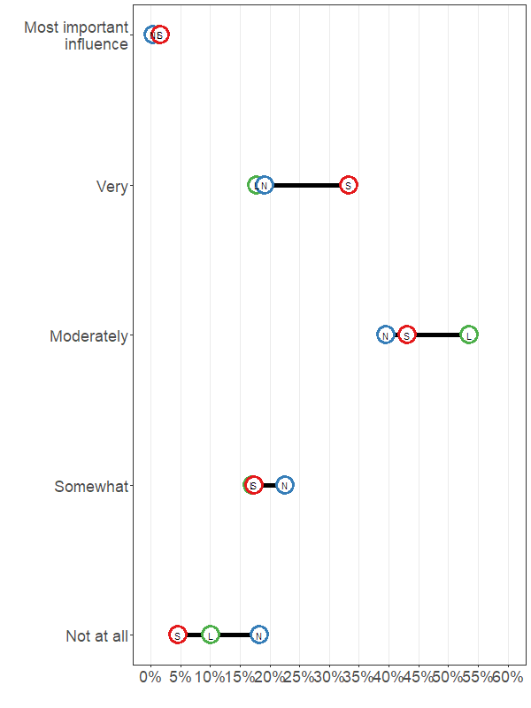
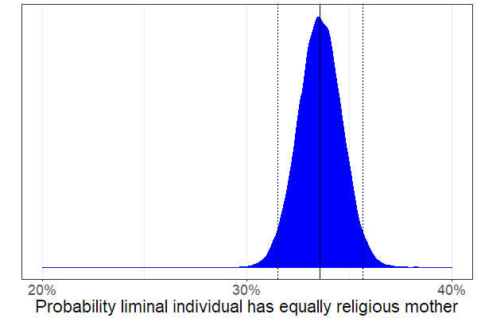
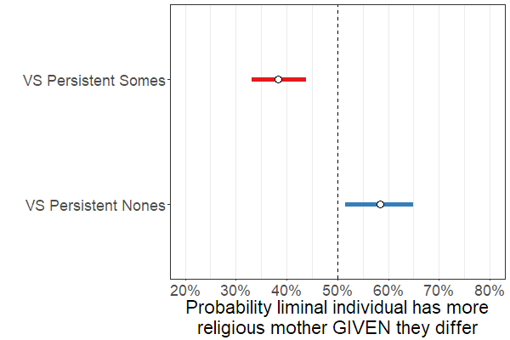
Self-rated religiosity(mother)
RESULTS
20

Slide 21
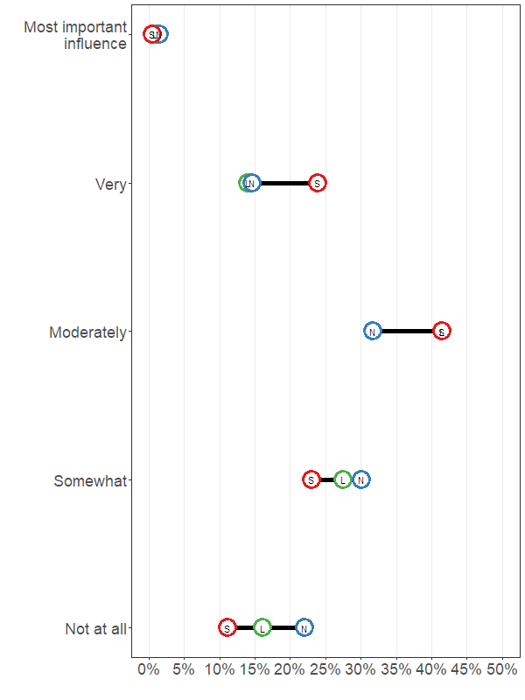
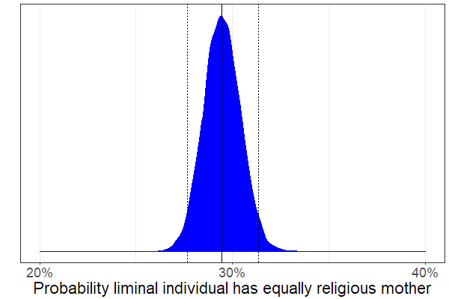
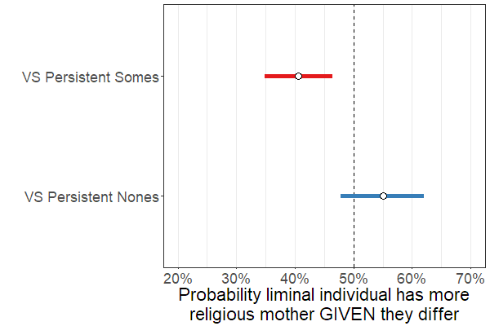
Self-rated religiosity (father)
RESULTS
21

Slide 22
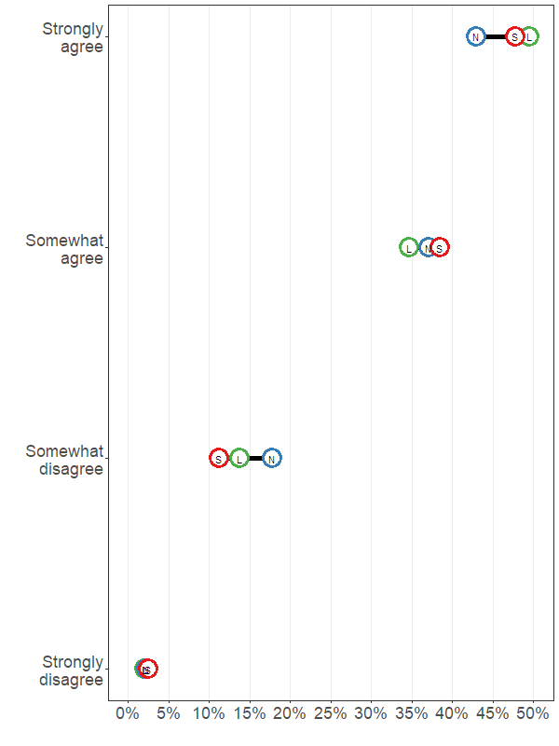
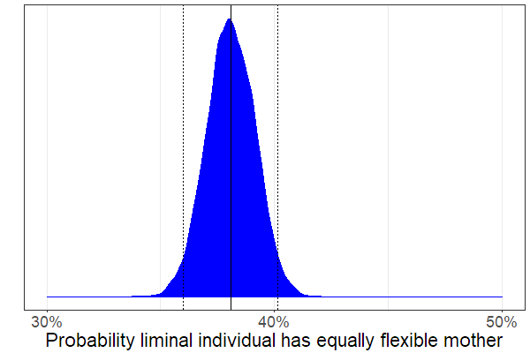
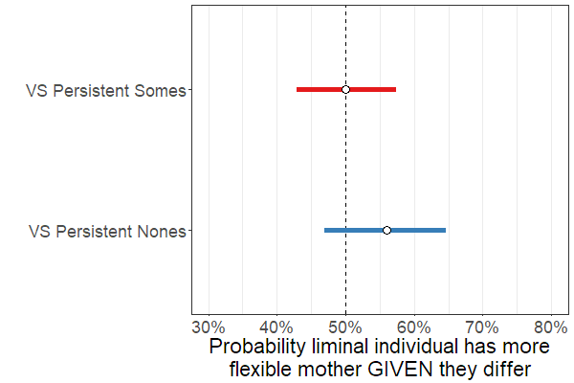
Rules should be flexible (mother)
RESULTS
22

Slide 23
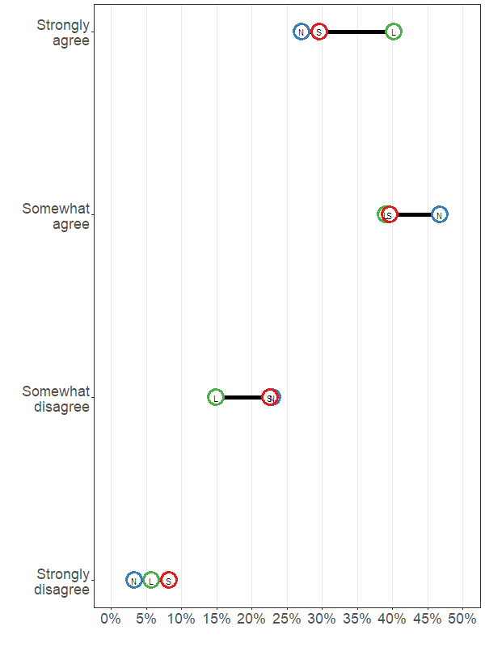
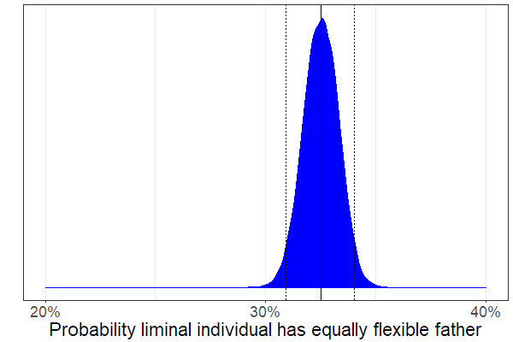
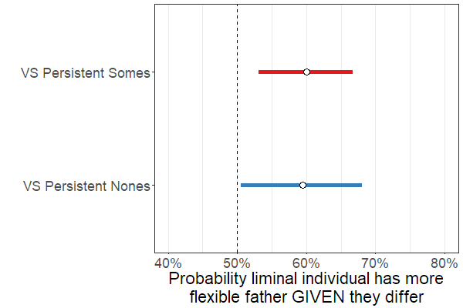
Rules should be flexible (father)
RESULTS
23

Slide 24
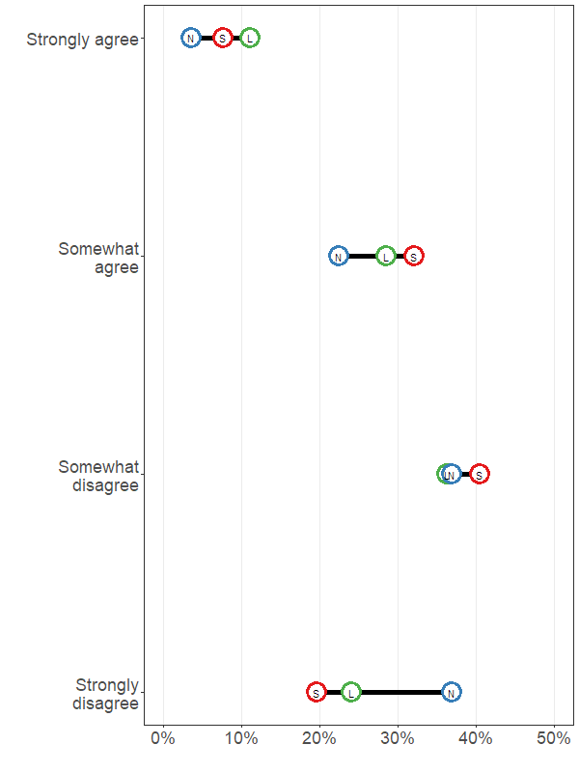
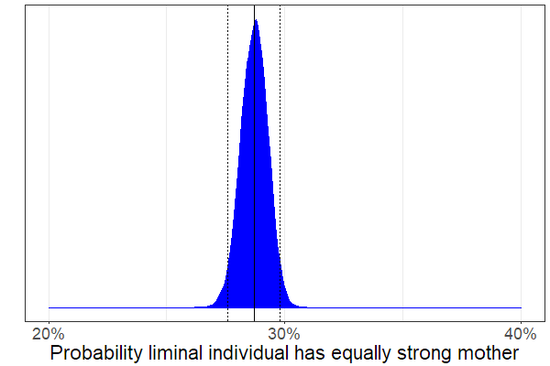
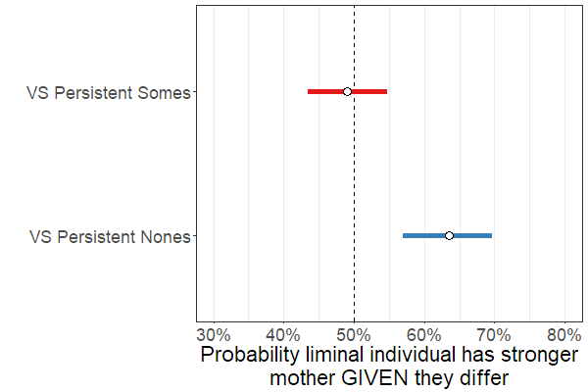
Should change lifestyle to match family’s values (mother)
RESULTS
24

Slide 25
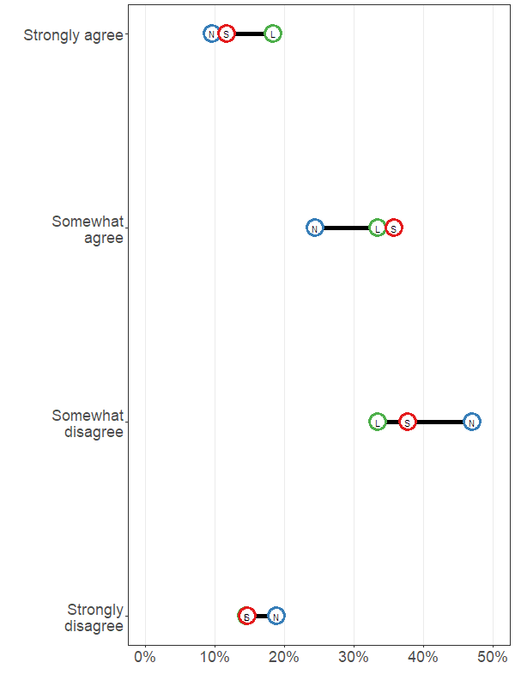
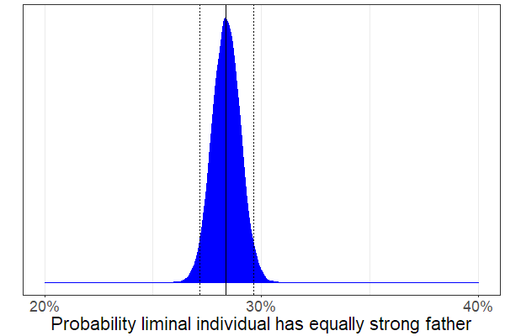
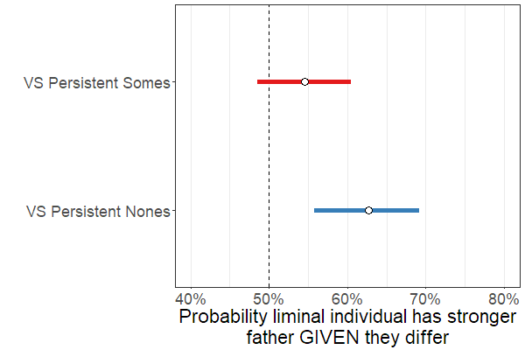
Should change lifestyle to match family’s values (father)
RESULTS
25

Slide 26
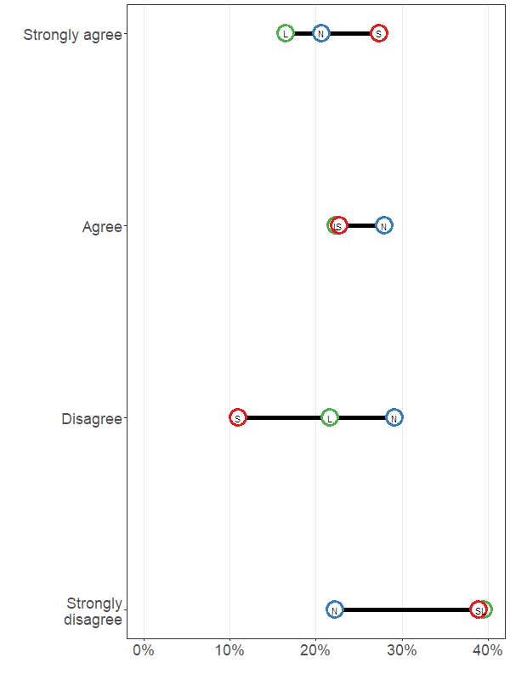
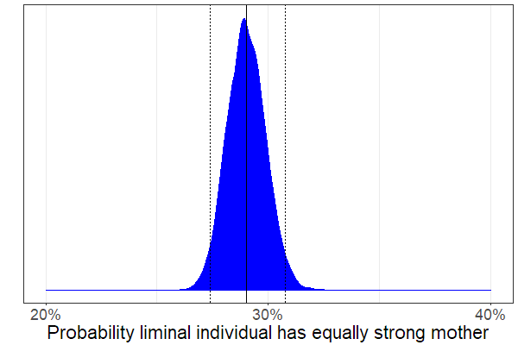
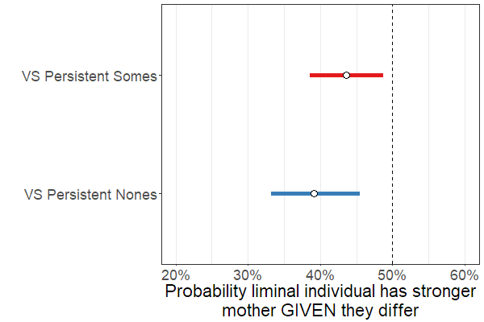
All children should receive religious instruction (mother)
RESULTS
26

Slide 27
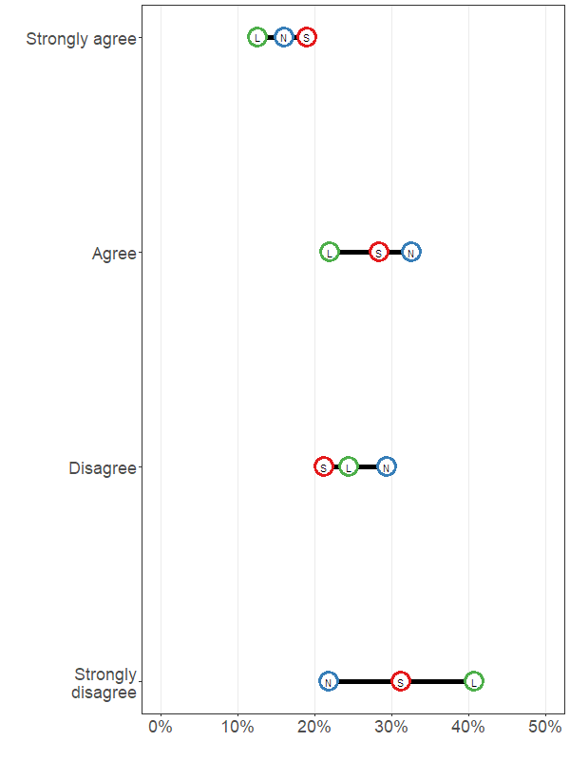
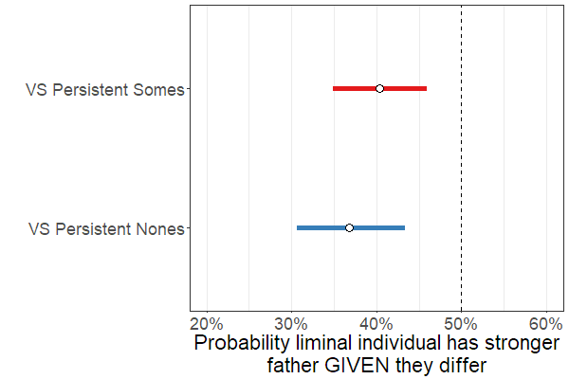
All children should receive religious instruction (father)
RESULTS
27

Slide 28
Main takeaways
DISCUSSION
The liminally religious have parents who…
…lie between Somes and Nones on service attendance and religiosity
...believe more strongly than Nones that people’s lifestyle should align with their family’s values
…are less-likely to think that all children should receive religious instruction
And fathers who…
…endorse more flexible rules
28

Slide 29
Liminals’ parents
BACKGROUND
Liminals
Religiously in between
Nones
Somes
Liminals
Conforming but Flexible
Nones
Somes
29

Slide 30
Simon G. Brauer
Ph.D. Candidate in Sociology
Duke University
simon.brauer@duke.edu
simonbrauer.github.io (website)

Slide 31
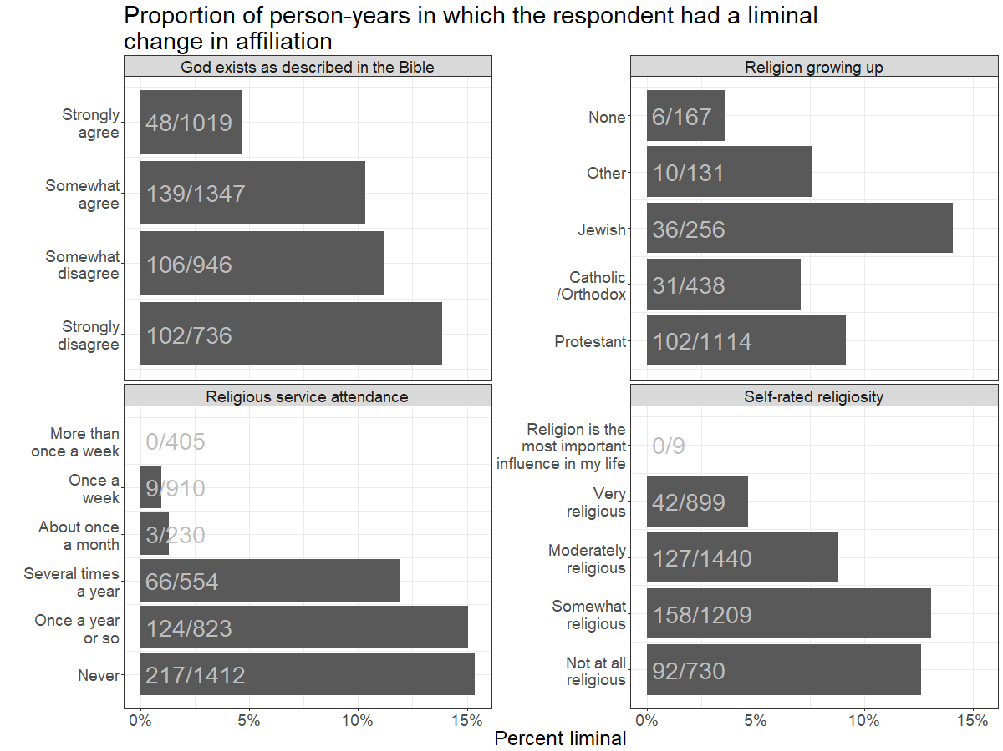
RESULTS
31

Slide 32
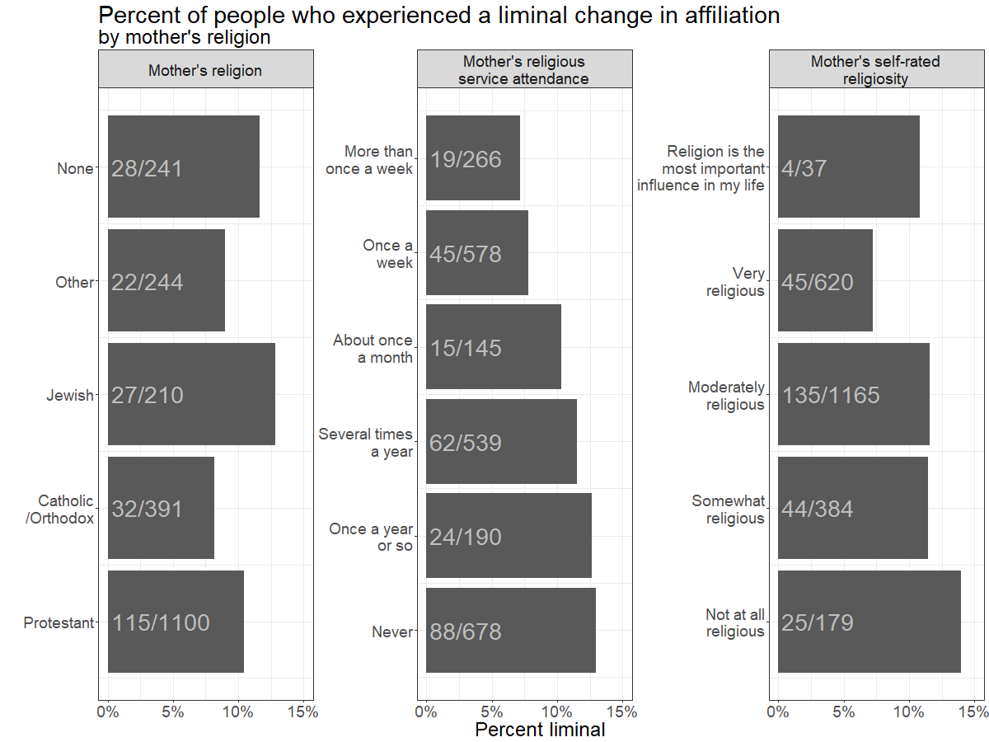
RESULTS
32

Slide 33
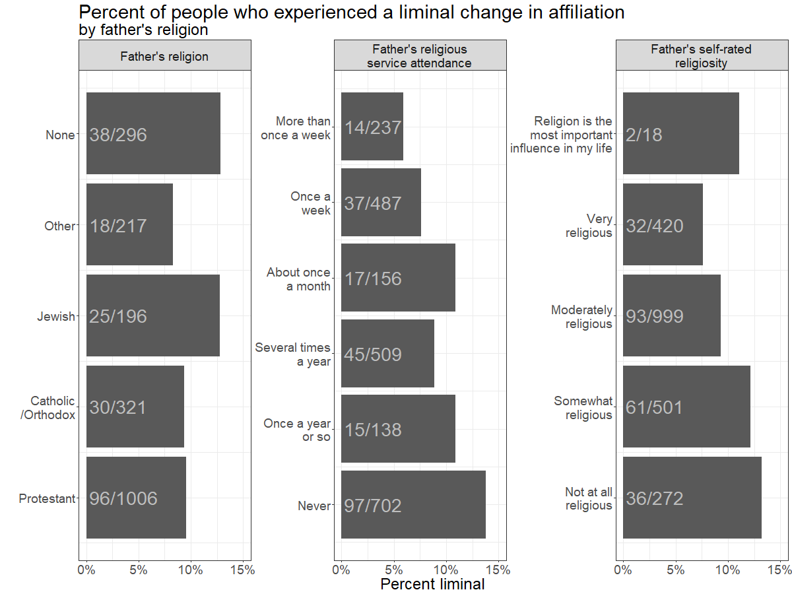
RESULTS
33

Slide 34
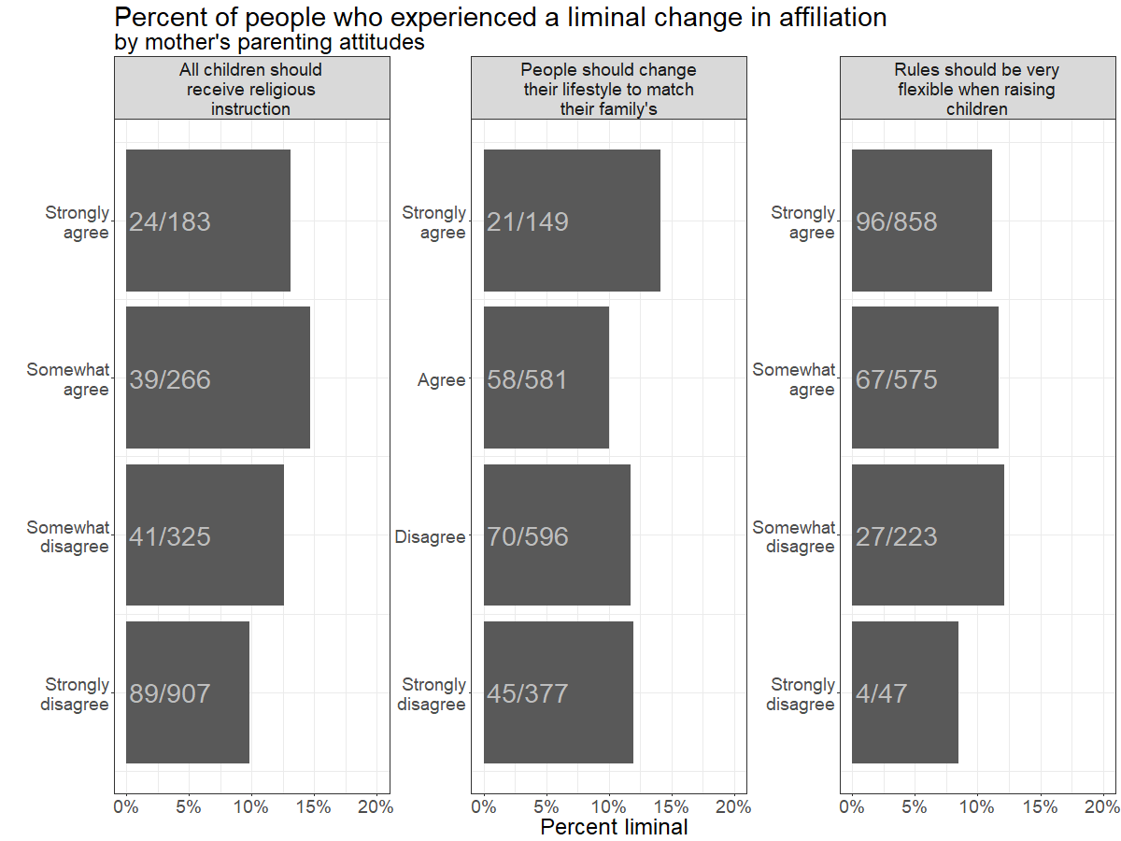
RESULTS
34

Slide 35
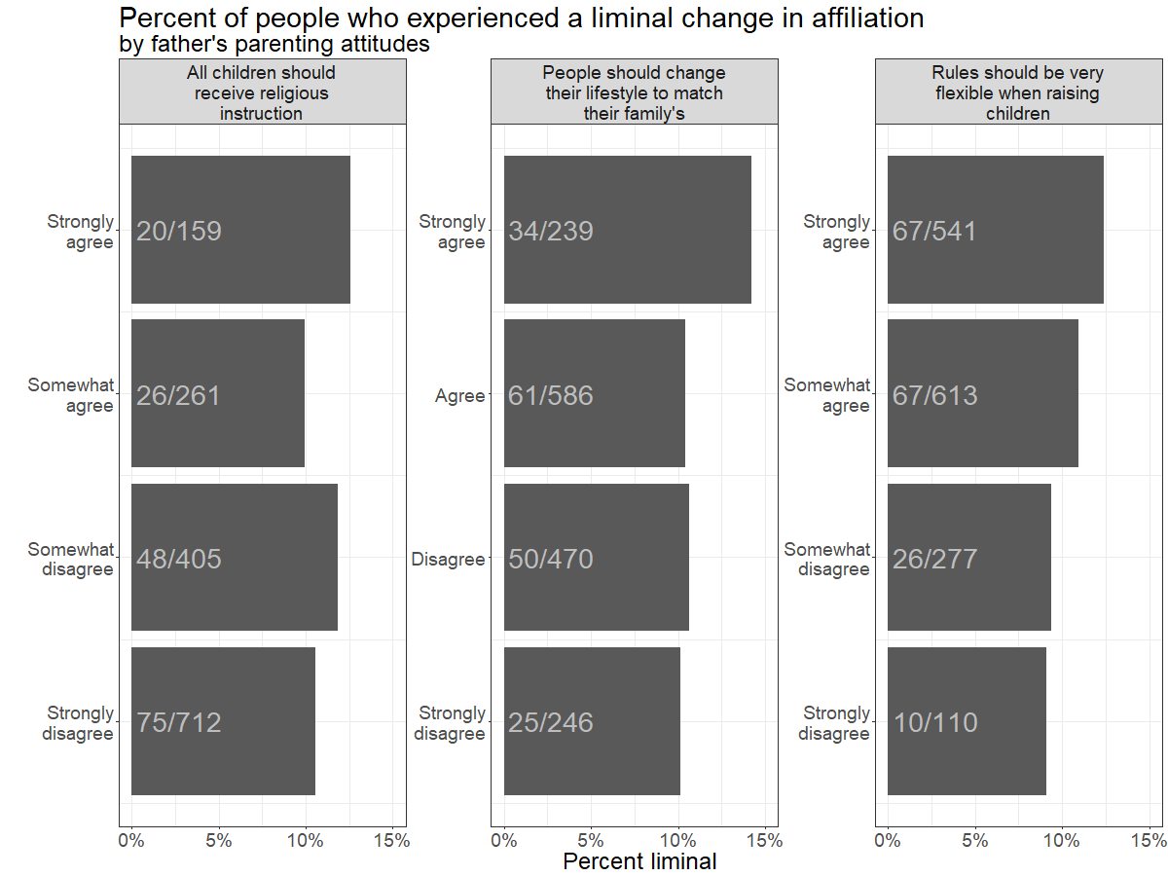
RESULTS
35

Slide 36
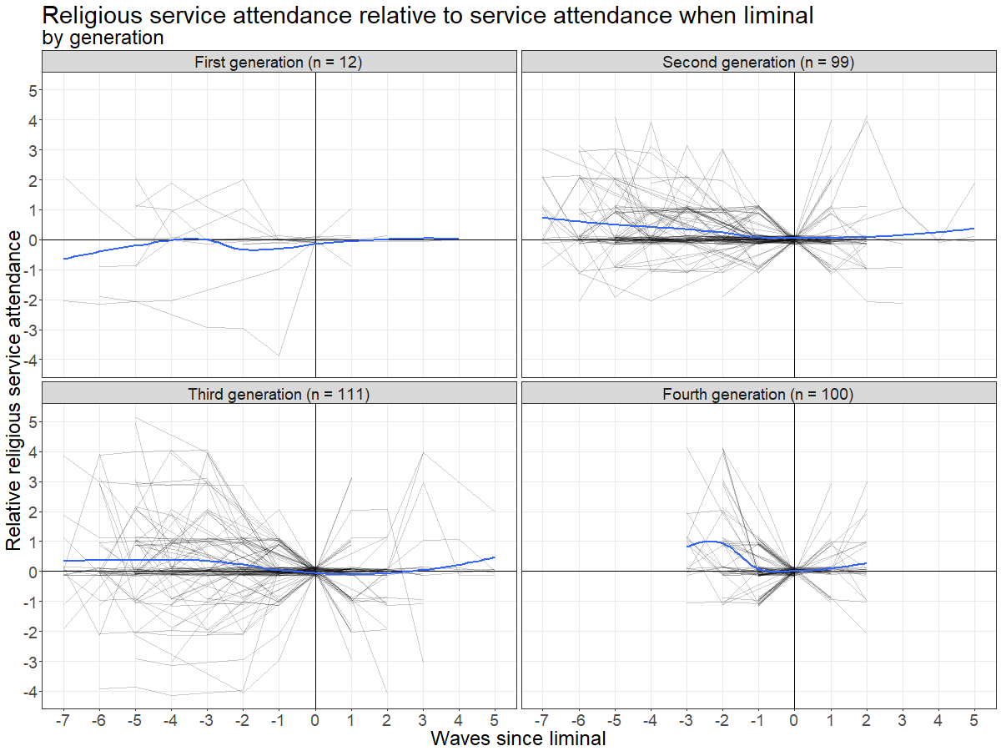
RESULTS
36

Slide 37
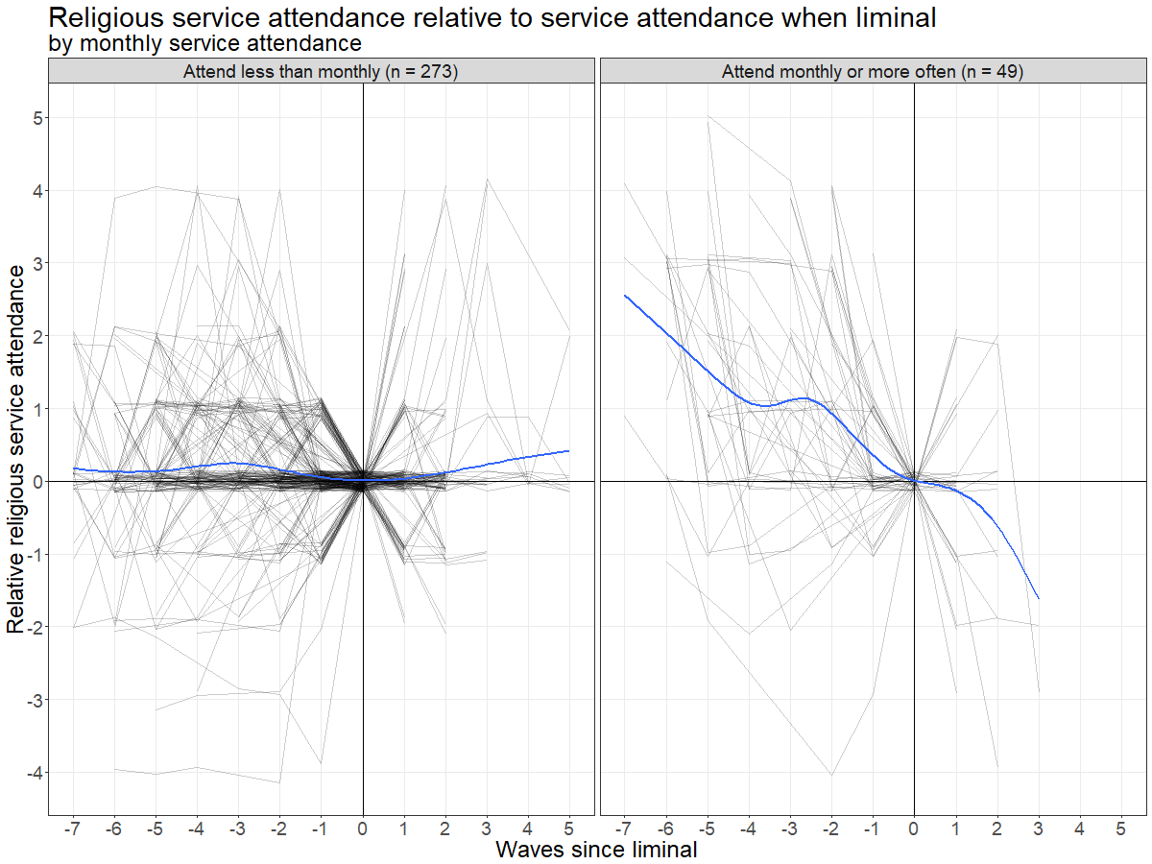
RESULTS
37

Slide 38
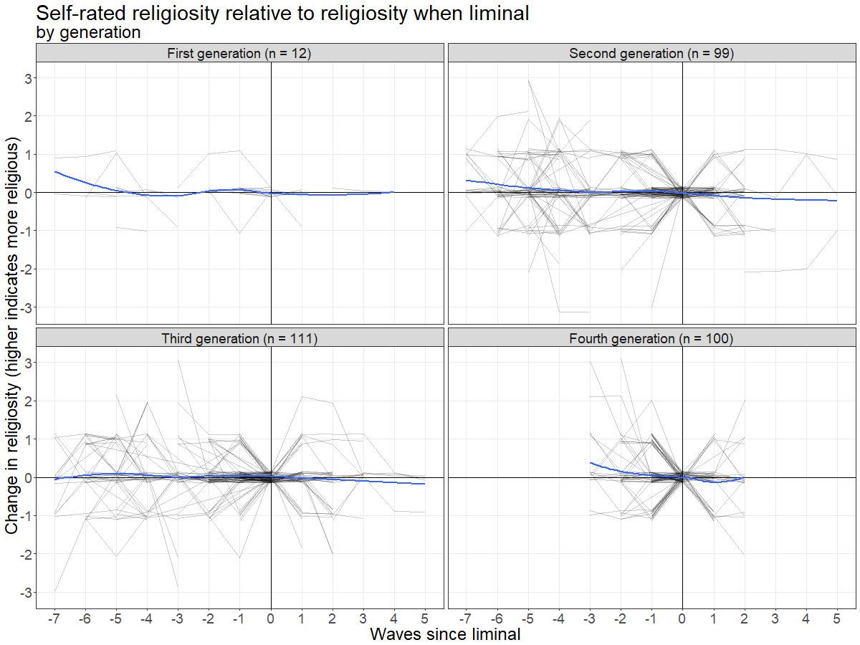
RESULTS
38

Slide 39
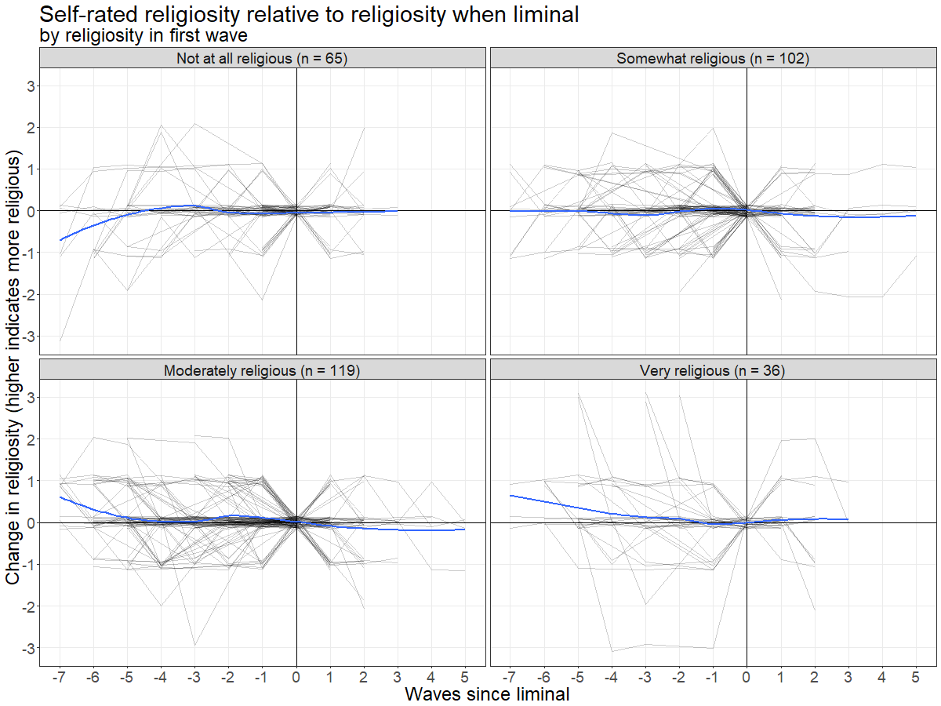
RESULTS
39

Slide 40
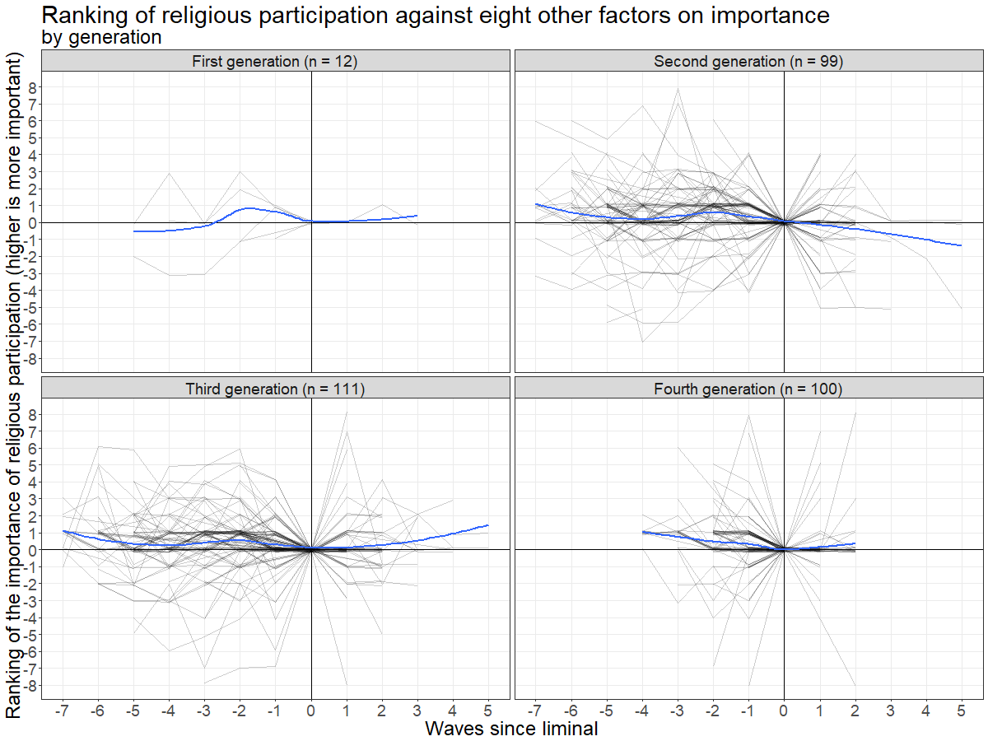
RESULTS
40

Slide 41
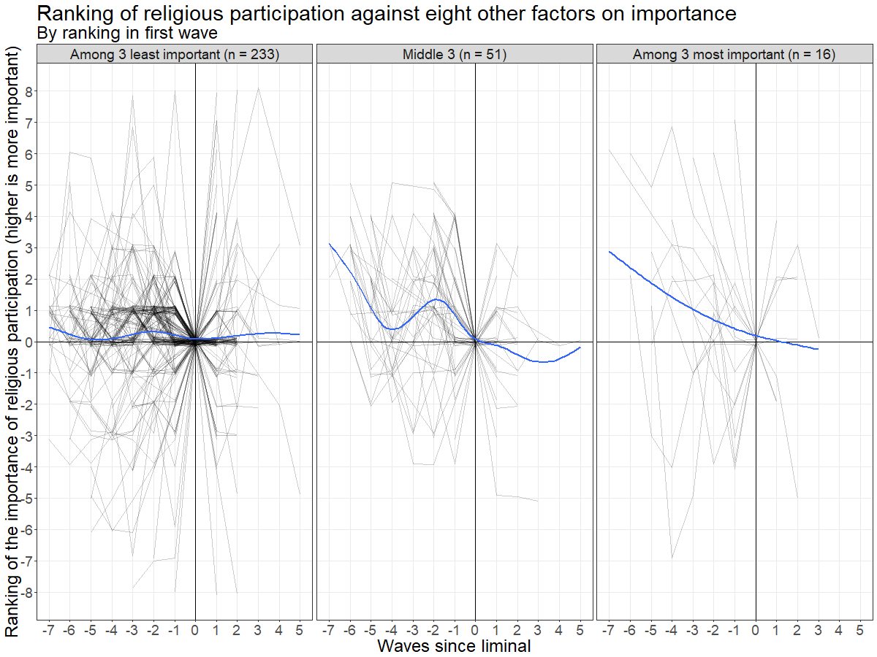
RESULTS
41

Slide 42
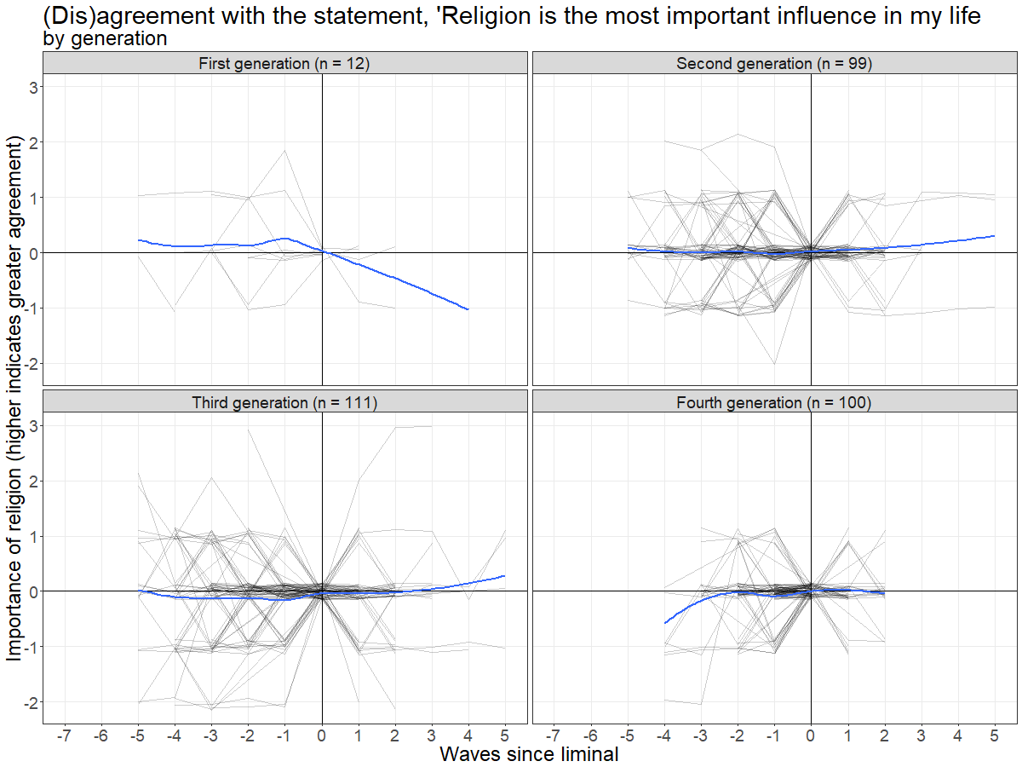
RESULTS
42

Slide 43
RESULTS
43

